Slide 1

ECIV
European Circular Innovation Valley
Montse Guerrero
Sustainability and Circular Economy
Vice-director in SODENA
CONAMA 02.12.2024

Slide 2
CONTENTS
Background
ECIV project in a nutshell
Consortium
Objectives
Milestones
Methodology
Mission-oriented value chains
Ongoing proges

Slide 3
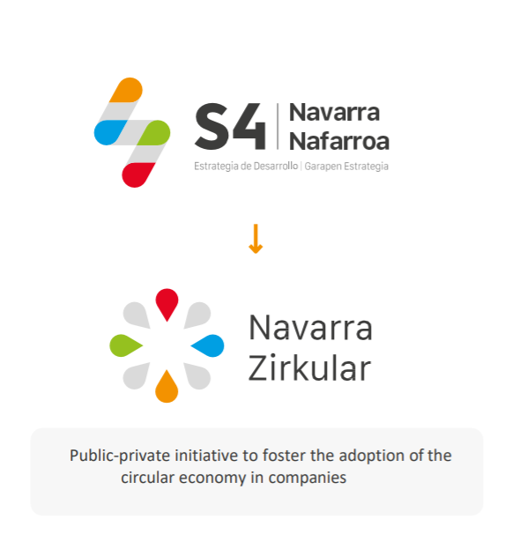
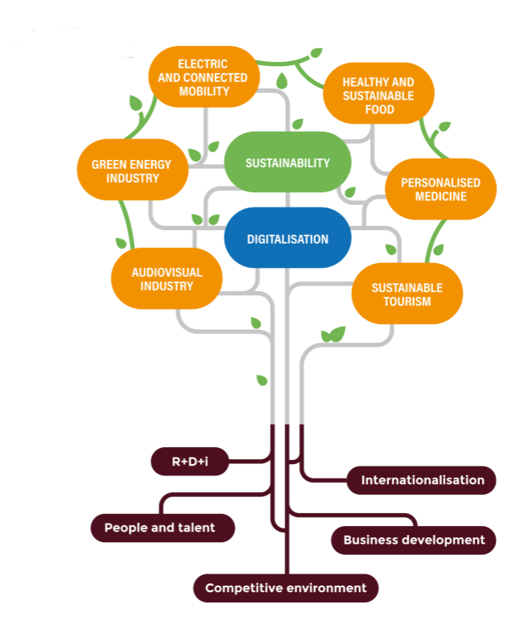







ECIV PROJECT BACKGROUND
TOOLS FOR CIRCULAR ECONOMY: NAVARRA ZIRKULAR
Challenges S4 2022
/ R1. Transformation of the automotive sector
/ R2. Sustainable mobility
/ R3. Plant-based protein
/ R4. Organic food value chain
/ R5. Energy Storage
/ R6. Personalised Medicine
/ R7. Circular Economy
/ R8. Artificial Intelligence
/ R9. Digital Innovation Hub
/ R10. Industrialized and sustainable construction
The Circular Economy Regional hub

Slide 4
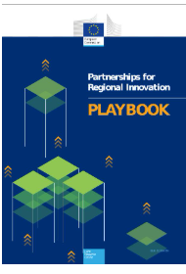
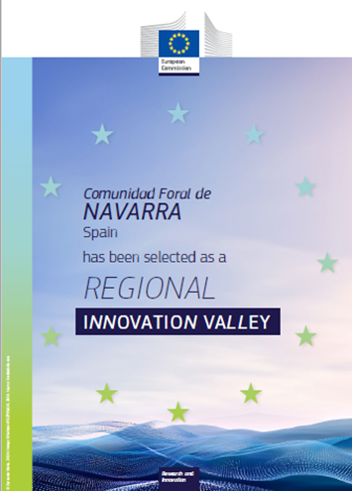

ECIV PROJECT BACKGROUND
REGIONAL INNOVATION VALLEY
2022 PRI - Partnerships Regional Innovation-CoR-JRC
Navarra is a Regional Innovation Valley
Notes:
Participación en el Proyecto Piloto Consorcios para la Innovación Regional- PRI- Partnerships for Regional Innovation (PRI) new experimental policy. PRI pilot.
PRI=A new strategic approach to innovation-driven territorial transformation, linking EU priorities with national plans and place-based opportunities and challenges
▪ Impact-based partnerships for sustainability transitions that create economic, social & environmental value
▪ Participatory governance framework in support of forward-looking policy
▪ New ways of working across government departments and levels focused on solving territorial challenges
ACTIONbook: a guide to building strategic partnerships for green and digital transitions. It includes practical activities, tools, and examples to help regions develop innovative solutions tailored to their specific needs.
PRI goes beyond S3 in the context of both the green and digital transition:
• S3 is limited to ERDF innovation funds
• PRI considers other essential policies for transformation (e.g. energy, transport, environmental, demand side policies, skills, regulation)
• Partnerships are broader (beyond STI actors)
• Transformative Innovation Policies are designed as policy mixes or portfolios of projects/instruments.
PRI- el objetivo de la Innovación es resolver problemas y necesidades locales con relación a los grandes retos sociales. Afecta a un ecosistema de Innovación muy dinámico y multi-dimensional y se genera la Innovación en la colaboración de las redes regionals y supraregionales, y une la oferta con las necesidades de la demanda.- Stakeholders engagement beyond fund beneficiaries.
Selección de las 100 RIVs basada en:
• build on Smart Specialisation Strategies and, where applicable, on the participation in the PRI initiative
• involve regions with aligned areas of specialisation and complementary capabilities
• include partnersfrom(at least two) less innovative regions and (at least one) more innovative regions
• prioritise 3-4 interregional innovation projects linked to key EU priorities
RIV- Enhance the coordination and direction of their research and innovation investment and policies, at regional level and to collaborate on inter-regional innovation projects including in deep tech innovation, linked to key EU priorities.

Slide 5




ECIV Project in a nutshell
19 entities
9 territories
5 years
2 open calls
ECIV European Circular Innovation Valley
The project will create an interregional ecosystem within the European Union to transform value chains with the aim of developing and delivering new circular solutions to the market with a mission-oriented approach.
Overal budget: 27.162.498,00 €
EU contribution: 13.579.061,51 €

Slide 6
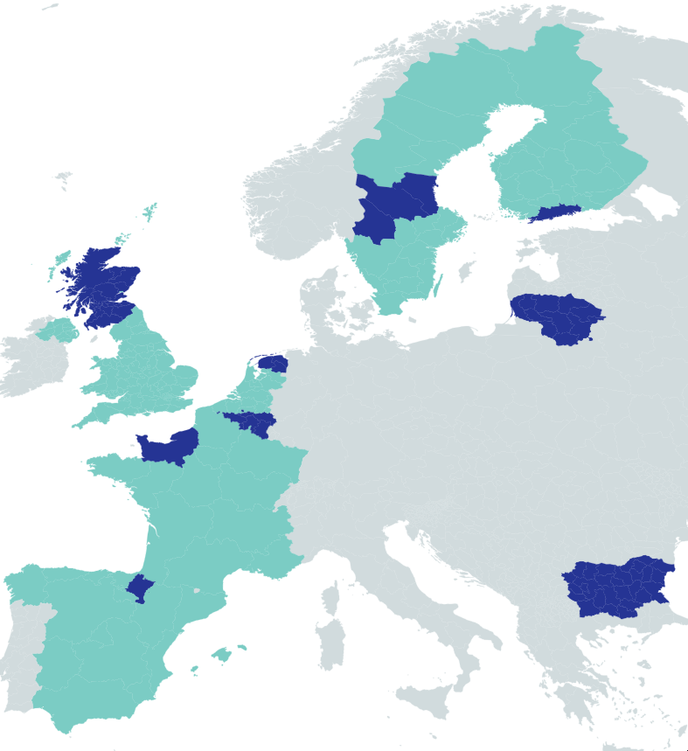
ECIV Consortium
1.(Coordinator) – Government of Navarra (GN)
2. Development Agency of Navarra (SODENA)
3. Northern Netherlands Alliance (SNN)
4. Provincie Groningen (GRO)
5. Provincie Fryslan (FRY)
4. Provincie Drenthe (DTH)
7. University of Groningen (UGRO)
8. Fryslan Innovation Foundation (SIF)
9. Region of Dalarna (DAL)
10. Region of Värmland (VÄR)
11. Region of Gävleborg (GÄV)
12. Region Normandie (NOR)
13. Ministry of Innovation and Growth of Bulgaria (MIGB)
14. Service public de Wallonie Economie (SPW)
15. Lithuania’s Innovation Agency (IAL)
16. Helsinki-Uusimaa Regional Council (HURC)
17. Scottish Enterprise [Scotland Economic Development Agency] (SE)
18. University of Strathclyde/Dptmt. of Industrial Biotech Innovation Centre (IBioIC)
19.ACR + (Association of Cities and Regions for sustainable Resource management)

Slide 7
ECIV Objectives
Generating sustainable growth and development in the participating regions. Taking advantage of the economic opportunities of circularity, creating new markets and new businesses.
ECIV targets the development of market-oriented innovations to build New Circular Value Chains
Promoting innovation all the three steps of industrial value chains:
  New Materials
  New Industrial processes
  New Business Models and Policies
ECIV will create a "dance floor" where agents and interest groups from innovation ecosystems will establish connections to propose solutions to the challenges that circular transformation offers working in our main industrial value chains.
To create the European Circular Innovation Valley (ECIV), which will connect different EU territories/regions with two interrelated purposes (green & economic)

Slide 8
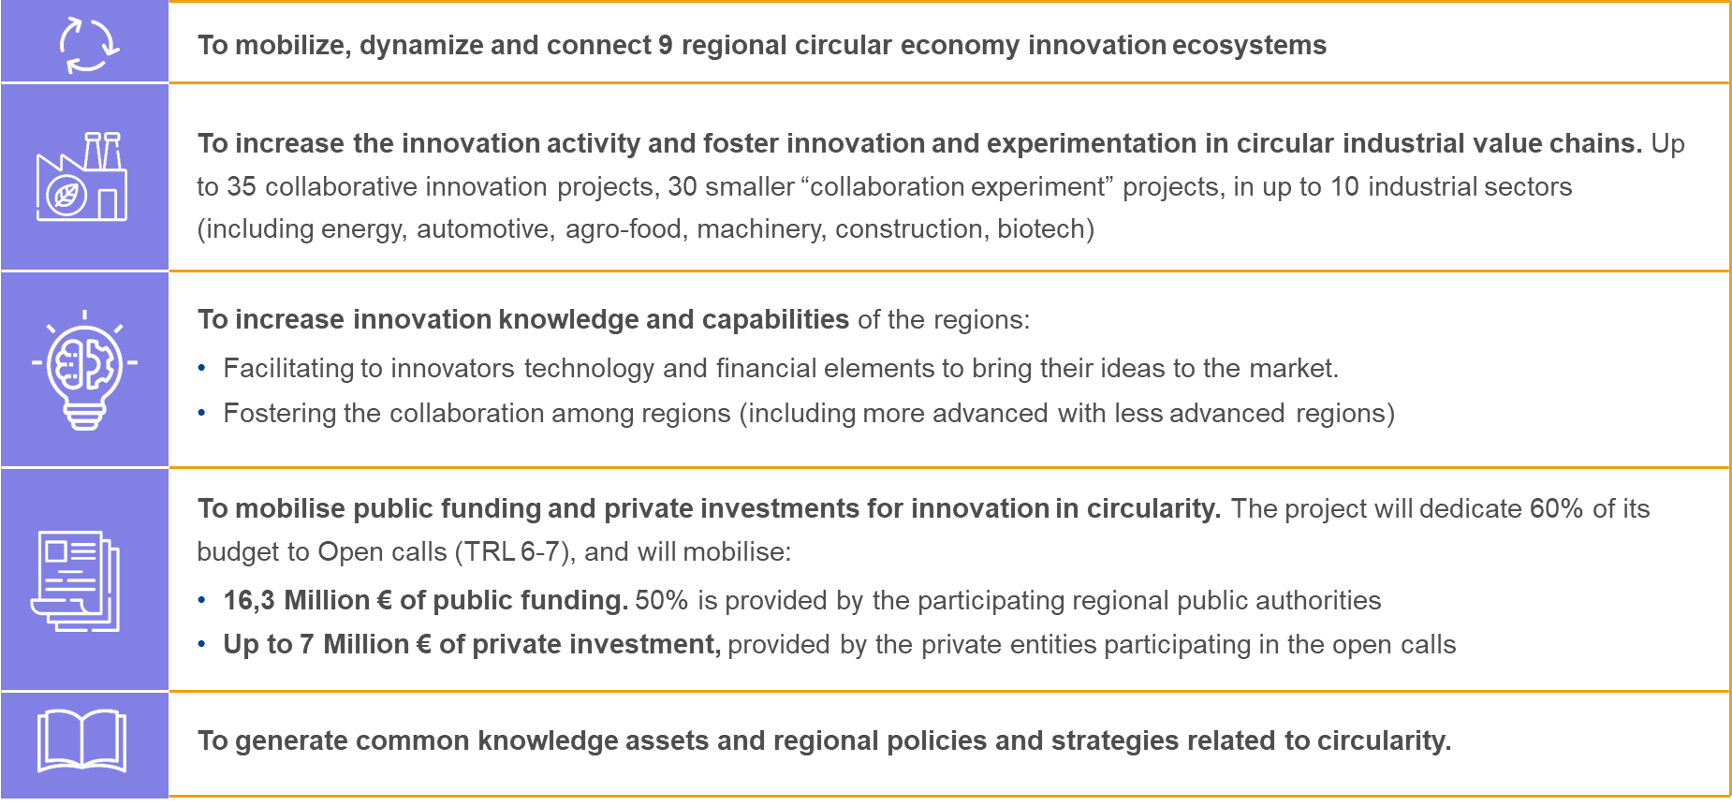
ECIV Milestones

Slide 9
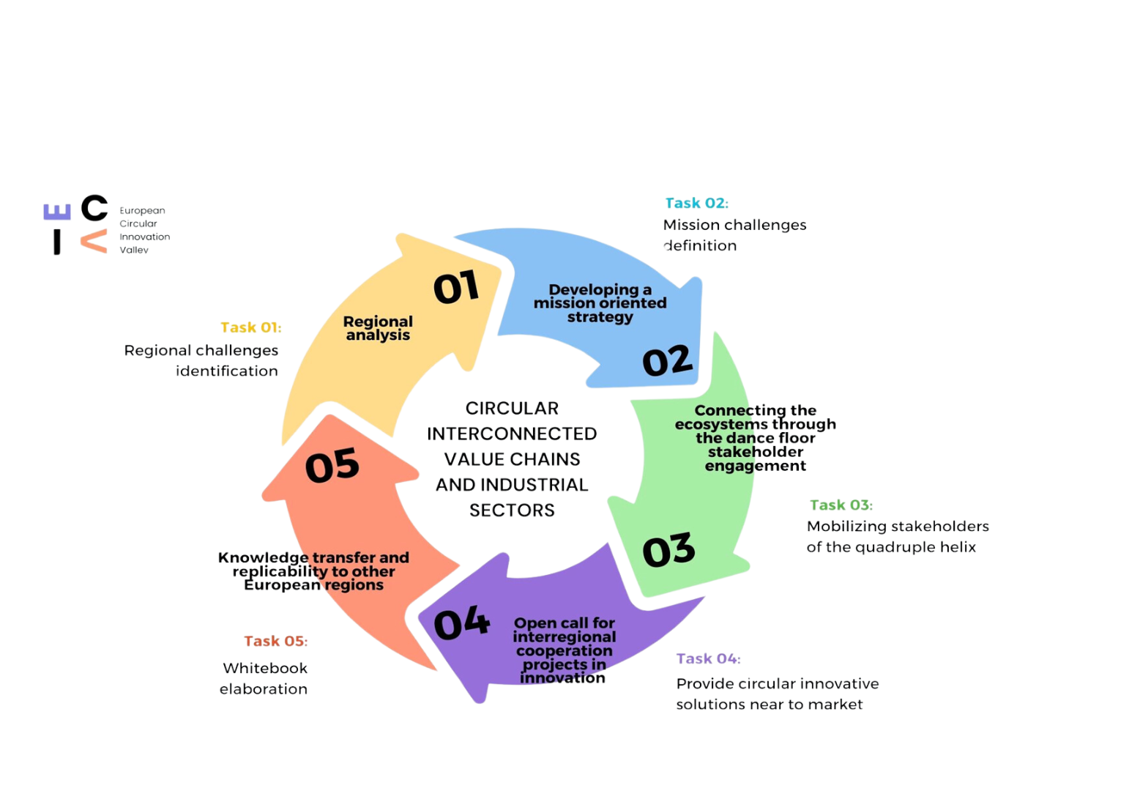
ECIV Methodology

Slide 10

Mission-oriented value chains
How to turn challenges into missions?
Importance of cross-sectoral challenge
Placed-based mission-oriented approach based on an industrial strategy articulated not through sectors, but through challenges.
Based on the missions, inter-regional “sub-missions” development
The objective is to achieve and implement collaborative innovative circular projects.

Slide 11
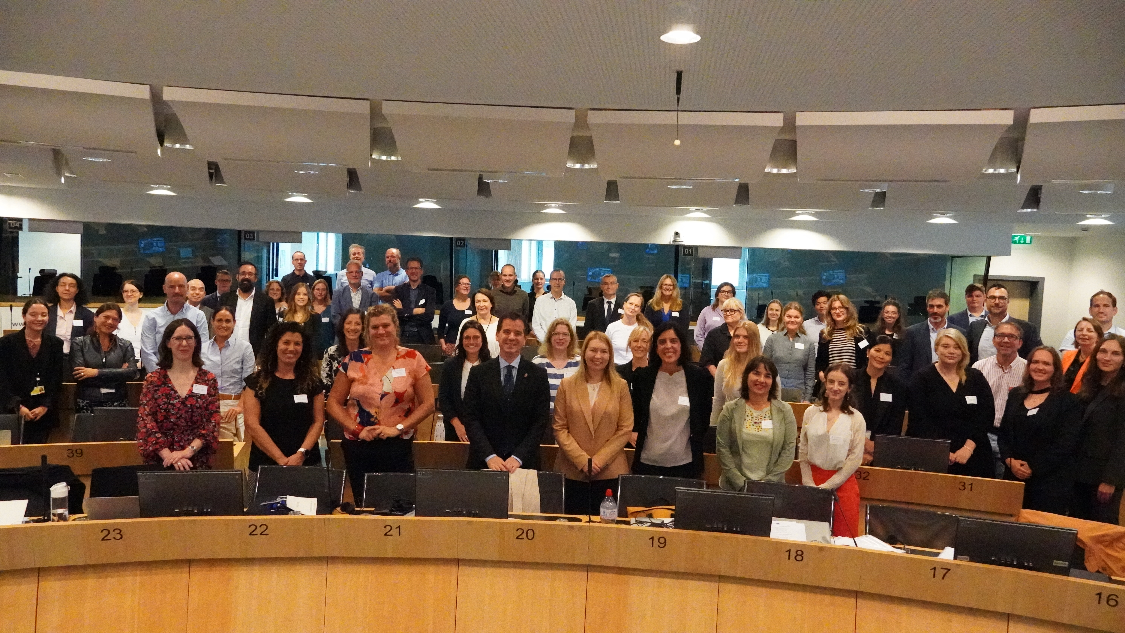
Ongoing progess
Kick of Meeting
7 – 9 Sept
Brussels

Slide 12
Ongoing progress
Regional challenges identification
CCRI self assessment tool
Questionnaires
Ecosystem dinamization
Stakeholders engagement
Knowledge transferred among partners
Missions – challenges definition
Experts on inter-regional mission-oriented development

Slide 13
CONTACT
eciv@sodena.com
mguerrero@sodena.com
mpedrosa@sodena.com

